Slide 1
Link prefetching : A Website Fingerprinting Defense for Tor Vaibhav Sharma, Taejoon Byun, Se Eun Oh and Elaheh Ghassabani Final project of CSCI5271: Introduction to Security December 7,2015

Slide 2
Outline
Anonymity network
Website fingerprinting attack
Related works
Link prefetching
Experiments
Conclusion
Future works

Slide 3
Anonymity Network
Anonymity use case
Normal people
Circumvent censorship
Skirt surveillance
Protect privacy from identity theft (ISP, websites …)
Citizen journalists (in repressive nations)
Activist and whistleblowers
Military
Intelligence gathering
(geographically) Hidden services
https://www.torproject.org/about/torusers.html.en

Slide 4
Anonymity Network
How Tor works
Tor node
Unencrypted
Encrypted
Alice
1. Alice's Tor client obtains a list of Tor nodes from a directory server.
Charlie
Bob
https://www.torproject.org/about/overview.html.en#thesolution

Slide 5
Anonymity Network
How Tor works
Tor node
Unencrypted
Encrypted
Alice
2. Alice's Tor client picks a random path to destination server.
Charlie
Bob
https://www.torproject.org/about/overview.html.en#thesolution

Slide 6
Anonymity Network
How Tor works
Tor node
Unencrypted
Encrypted
Alice
3. If at a later time, the user visits another site, Alice's Tor client selects a second random path.
Charlie
Bob
https://www.torproject.org/about/overview.html.en#thesolution

Slide 7
Website Fingerprinting
What is website fingerprinting?
Even when the payload is encrypted and anonymized, certain features cannot be hidden such as
Source and destination of the packets
Number of packets, timing and size
These features form a unique “fingerprint” of a website.
Amazon.com
Youtube.com
Facebook.com

Slide 8
Website Fingerprinting
Attack Model
The adversary targets a specific victim and tries to identify which website the victim visits.
Attacker trains a classifier under conditions similar to those of victim.
The adversary may have enough background knowledge about the user to reproduce his configuration.
Alice
Juarez, M. et al.: A Critical Evaluation of Website Fingerprinting Attacks. (2014).

Slide 9
Related Works (TODO)
Attacks
a
aa
ab
Defenses
a
ac

Slide 10
Idea
A simple and easy way to obfuscate eavesdropper?
The accuracy of website fingerprinting attack depends on the predictability of website fingerprints.
The attack assumes that the fingerprint of a visit to a website will be similar to the previous visits.
What if it is not so?
What if a fingerprint looks different for each visit?
Could randomized link prefetching provide extra defense against website fingerprinting attacks?

Slide 11
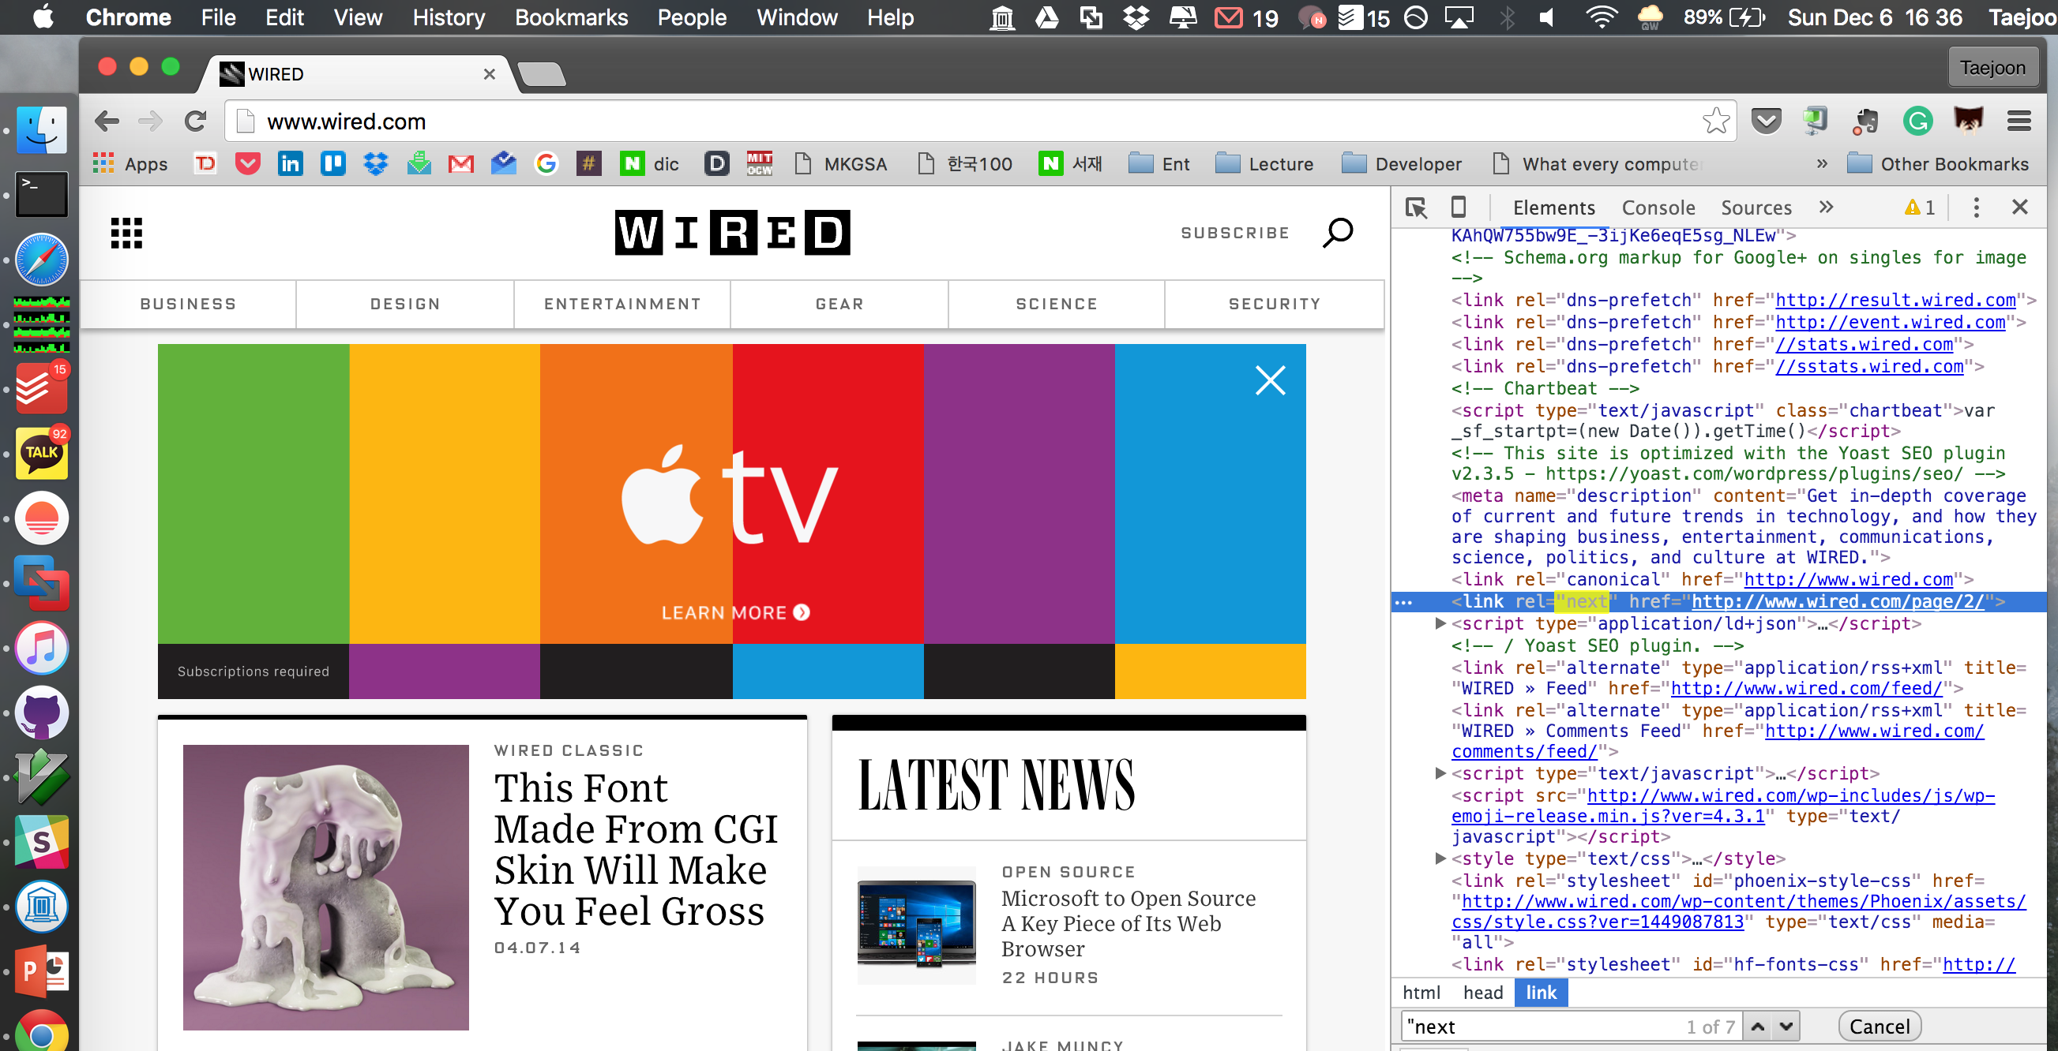
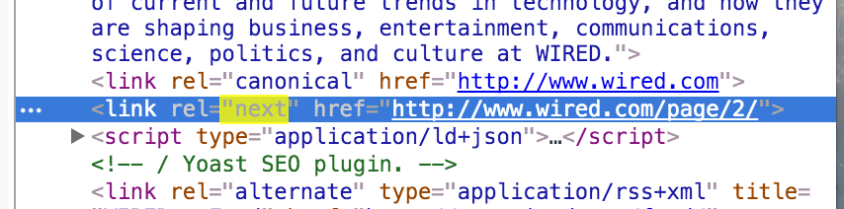
Link Prefetching
What is link prefetching
Link prefetching is a syntax to give web browsers a hint about documents that it should pre-fetch because the user might visit them in the near future.
A web page provides a set of prefetching hints to the browser, and after the browser is finished loading the page, and after an idle time has passed, it begins silently prefetching specified documents, storing them in its cache.
https://en.wikipedia.org/wiki/Link_prefetching

Slide 12
Link Prefetching
How many websites use prefetching?
Analyzed about 6,000 Alexa Top websites.
About 60 websites use at least one of pre-fetch features – {‘dns-prefetch’, ‘prefetch’, ‘next’, ‘prerender’}
Some of the website…
prefetching_websites.csv
01: website_url, prefetch_types
02: https://www.yahoo.com/, dns-prefetch
03: http://www.baidu.com/, dns-prefetch
04: http://www.amazon.com/, dns-prefetch
05: https://wordpress.com/, dns-prefetch
06: http://www.amazon.co.jp/, dns-prefetch
07: https://www.tmall.com/, dns-prefetch
08: http://www.hao123.com/, dns-prefetch
09: http://xhamster.com/,"dns-prefetch,next”
10: ...

Slide 13
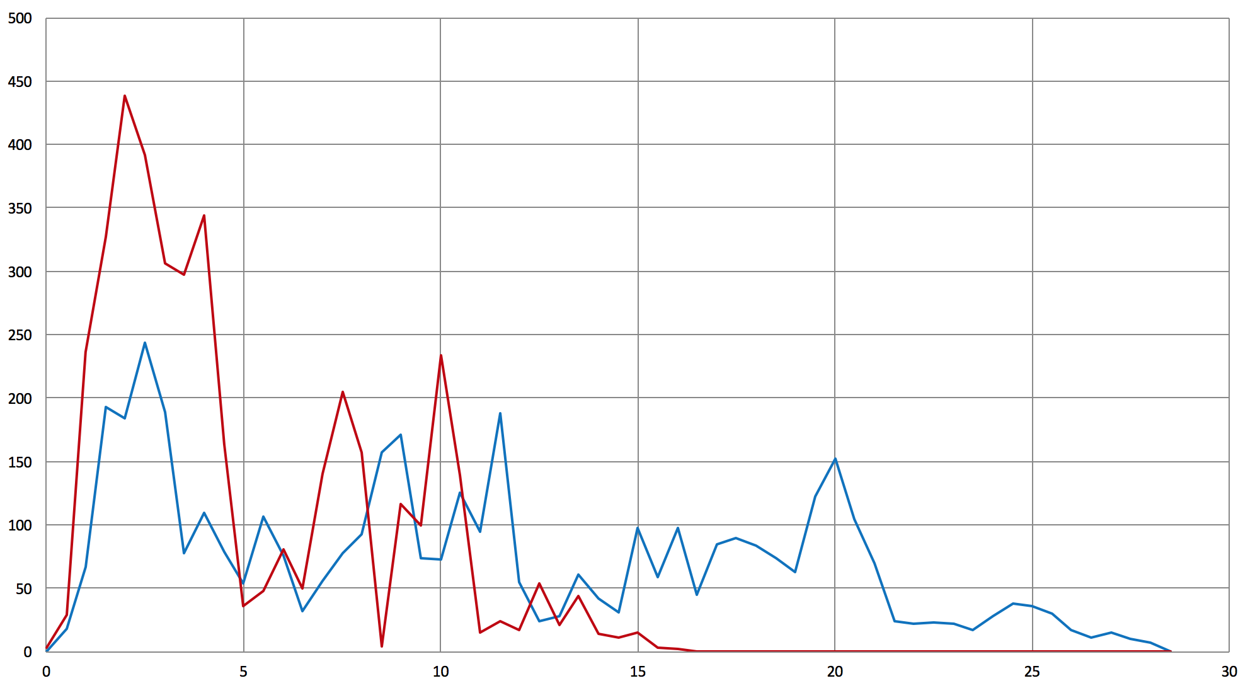
Link Prefetching
-- pre-fetch off
-- pre-fetch on
How does it look like?
# packets
Packets from www.wired.com
time (sec)

Slide 14
Research Questions
RQ1
Does prefetching itself provide an extra degree of defense?
RQ2
Can a victim obfuscate eavesdropper by simply turning off prefetching in their browser?
RQ3
Can prefetching be used as a browser-side defense mechanism?

Slide 15
Experiment
RQ1: Does prefetching itself provide an extra degree of defense?
Method
Capture 1: Capture packets for a list of prefetching websites.
Capture 2: Capture packets for a list of prefetching website, while the prefetching is turned off on the browser side.
Compare the two

Slide 16
Experiment
Experimental Setup
Configured two separate virtual machines to capture packets for 60 prefetching websites.
VM isolates experiment environment, removes all background noises.
By configuring two VMs and running them in parallel, we can minimize getting affected by the changes of websites over time.
Pre-fetch on
Pre-fetch off
VM1
60 websites
VM2

Slide 17
Experiment
Experimental Setup
Used a python script (implemented by Juarez M et al.*) to automatically execute Tor browser multiple times and capture incoming/outgoing packets for each sessions.
Captured each url for 15 times.
Capture for each connection finishes when the site is fully loaded or exceeds timeout (120s)
*Juarez, M. et al.: A Critical Evaluation of Website Fingerprinting Attacks. (2014).

Slide 18
Experiment
RQ2: Can a victim obfuscate eavesdropper by simply turning off prefetching in their browser?
Use Case
Attacker trained their classifier assuming that user uses the default setting (pre-fetch on).
However, the victim turned off the pre-fetch setting on her/his browser.
The victim visits websites that uses prefetching.
Method
For a set of prefetching website, train the classifier where the prefetching was enabled.
Analyze victim traffic where prefetching is disabled.

Slide 19
Experiment
RQ3: Can prefetching be used as a browser-side defense mechanism?

Slide 20
Ongoing Works
For
document

Slide 21
Conclusion (so far) (TODO)
For
document

Slide 22
References (TODO)

Slide 23
THANK YOU

Slide 24
Overview (TODO)
Do we need an overview slide?
CFAR is an a
Do we
[1] Carzaniga et al., “Automatic Recovery from Runtime Failures”, ICSE, 2013.

Slide 25
Anonymity Network
What is anonymity network?
Internet is not anonymous by its design
HTTP traffic

